Slide 1
THE 8086 MICROPROCESSORS In
Minimum & Maximum mode

Slide 2
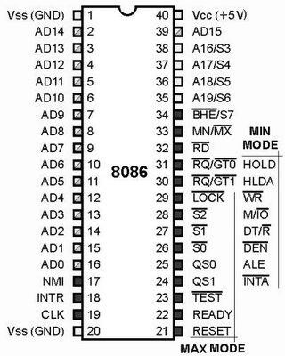
Pin layout of the 8086

Slide 3
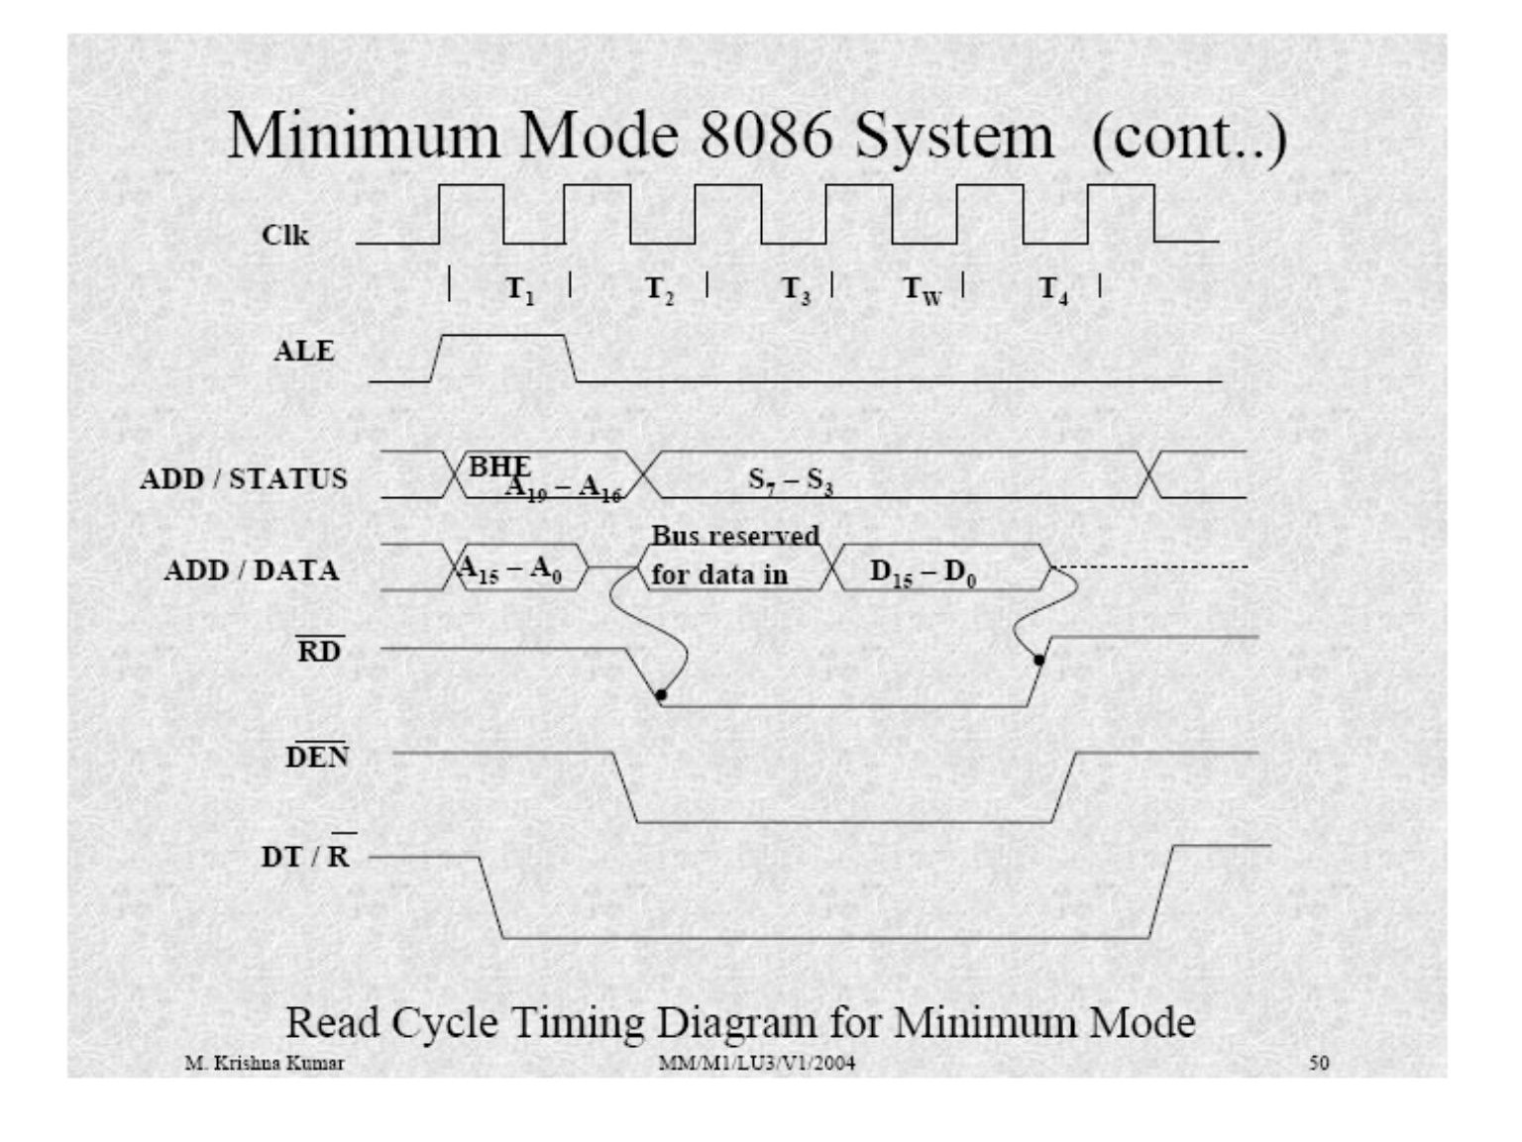
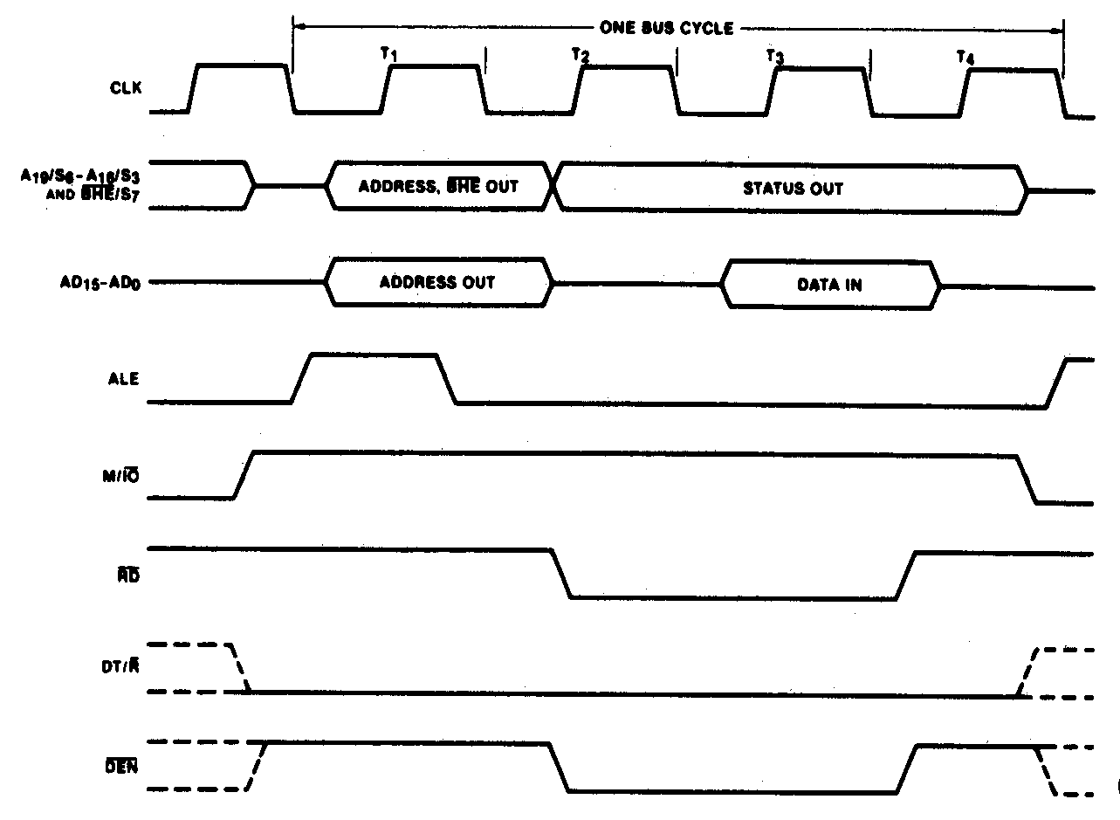
Read Bus Cycle (cont.)
Minimum-mode memory read bus cycle of the 8086

Slide 4
Minimum mode - READ
Hence the timing diagram can be categorized in two parts,
the timing diagram for read cycle
the timing diagram for write cycle.
The read cycle begins in T1 with the assertion of address latch enable (ALE) signal and also M / IO signal.
During the negative going edge of this signal, the valid address is latched on the local bus.

Slide 5
Minimum mode – READ continue…
 The BHE and A0 signals address low, high or both bytes. From T1 to T4
, the M/IO signal indicates a memory or I/O operation.
 At T2, the address is removed from the local bus and is sent to the output. The bus is then tri-stated. The read (RD) control signal is also activated in T2.
 The read (RD) signal causes the address device to enable its data bus drivers. After RD goes low, the valid data is available on the data bus.
 The addressed device will drive the READY line high. When the processor returns the read signal to high level, the addressed device will again tri-state its bus drivers.

Slide 6
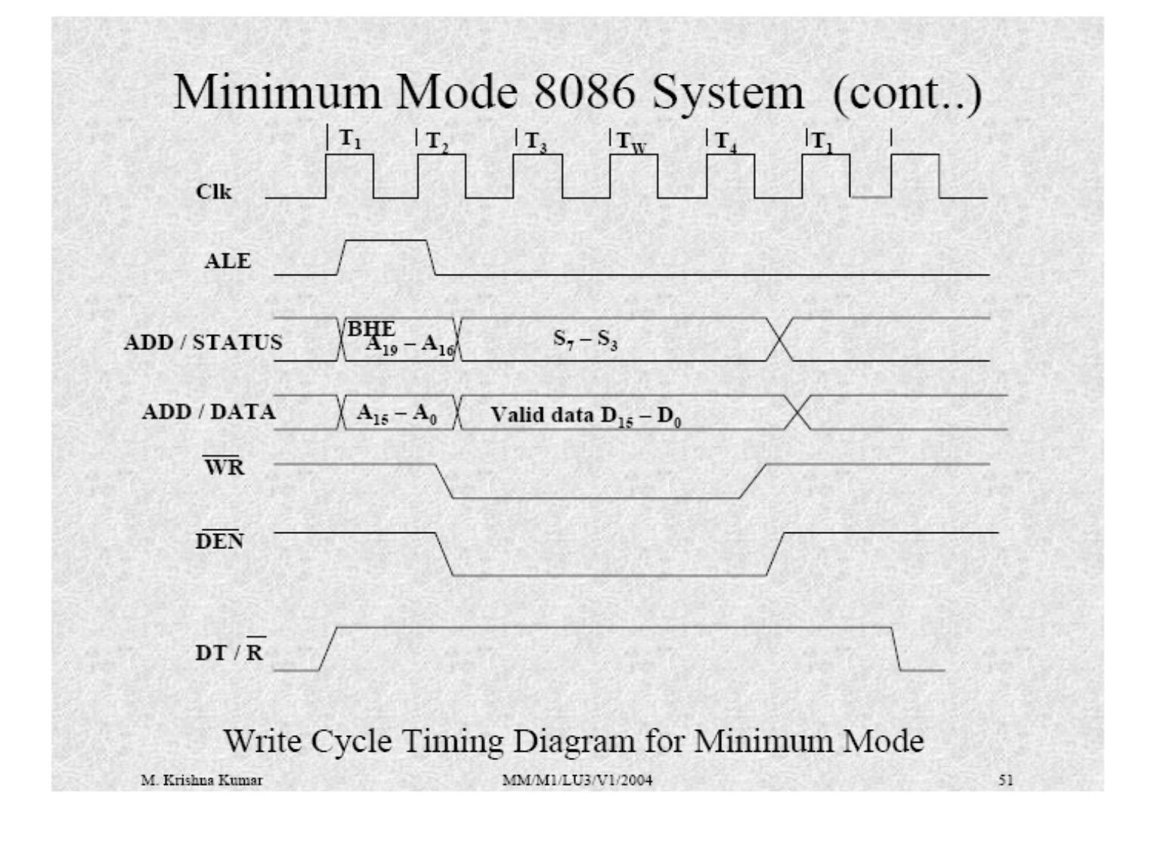
Read Bus Cycle (cont.)
Minimum-mode memory read bus cycle of the 8086

Slide 7
Minimum mode - Write
 A write cycle also begins with the assertion of ALE and the emission of the address. The M/IO signal is again asserted to indicate a memory or I/O operation. In T2, after sending the address in T1, the processor sends the data to be written to the addressed location.
 The data remains on the bus until middle of T4 state. The WR becomes active at the beginning of T2 (unlike RD is somewhat delayed in T2 to provide time for floating).
 The BHE and A0 signals are used to select the proper byte or bytes of memory or I/O word to be read or write.
 The M/IO, RD and WR signals indicate the type of data transfer as
specified in table below.

Slide 8
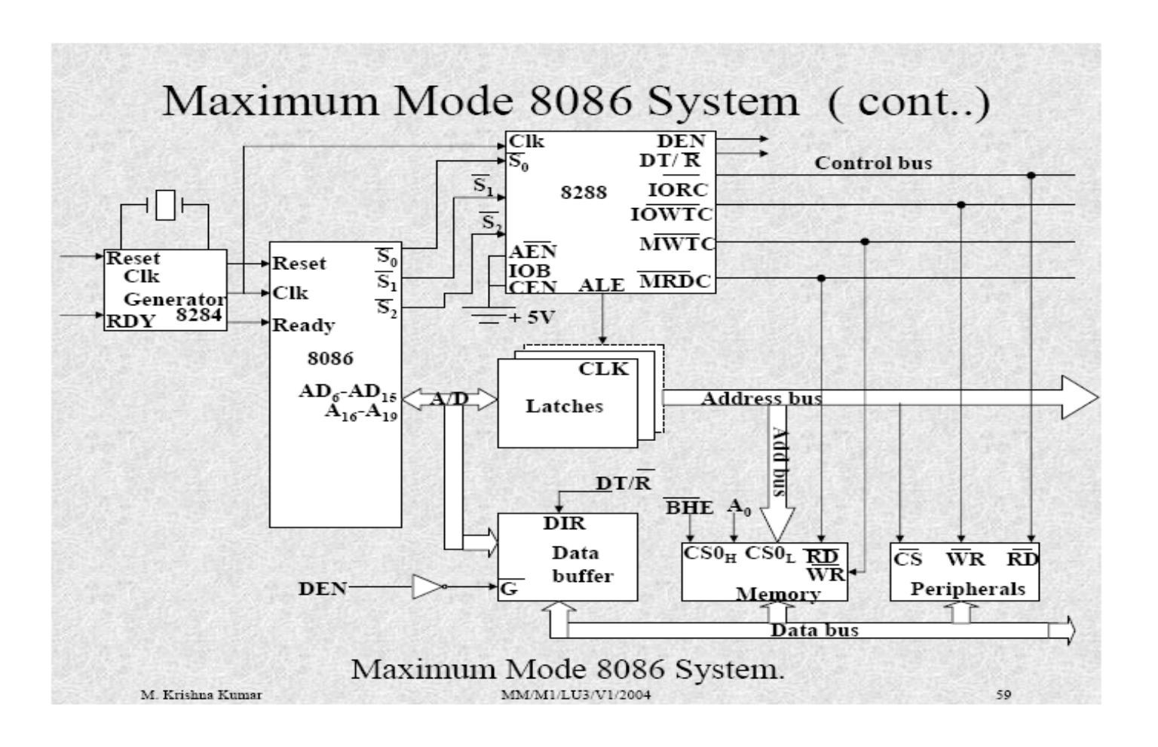
Maximum mode 8086 system

Slide 9
Maximum mode 8086 system continue…
In the maximum mode, the 8086 is operated by strapping the MN/MX pin to ground.
In this mode, the processor derives the status signal S2, S1, S0. Another chip called bus controller derives the control signal using this status information .
In the maximum mode, there may be more than one microprocessor in the system configuration.
The components in the system are same as in the minimum mode system.

Slide 10
Maximum mode 8086 system continue…
 The basic function of the bus controller chip IC8288, is to derive control signals like RD and WR ( for memory and I/O devices), DEN, DT/R, ALE etc. using the information by the processor on the status lines.
 The bus controller chip has input lines S2, S1, S0 and
CLK. These inputs to 8288 are driven by CPU.
 It derives the outputs ALE, DEN, DT/R, MRDC, MWTC,
AMWC, IORC, IOWC and AIOWC. The AEN, IOB and
CEN pins are specially useful for multiprocessor systems.

Slide 11
Maximum mode continue…
 AEN and IOB are generally grounded. CEN pin is usually tied to +5V. The significance of the MCE/PDEN output depends upon the status of the IOB pin.
 If IOB is grounded, it acts as master cascade enable to control cascade 8259A, else it acts as peripheral data enable used in the multiple bus configurations.
 INTA pin used to issue two interrupt acknowledge pulses to the interrupt controller or to an interrupting device. IORC, IOWC are I/O read command and I/O write command signals respectively . These signals enable an IO interface to read or write the data from or to the address port.
 The MRDC, MWTC are memory read command and memory write command signals respectively and may be used as memory read or write signals.
 All these command signals instructs the memory to accept or send data from or to the bus.
 For both of these write command signals, the advanced signals namely
AIOWC and AMWTC are available.

Slide 12
Maximum-Mode Interface (cont.)
 8288 bus controller
S2 | S1 | S0 | Function
0 | 0 | 0 | Interrupt acknowledge
0 | 0 | 1 | I/O read
0 | 1 | 0 | I/O write
0 | 1 | 1 | Halt
1 | 0 | 0 | Opcode fetch
1 | 0 | 1 | Memory read
1 | 1 | 0 | Memory write
1 | 1 | 1 | Passive
Bus status code

Slide 13
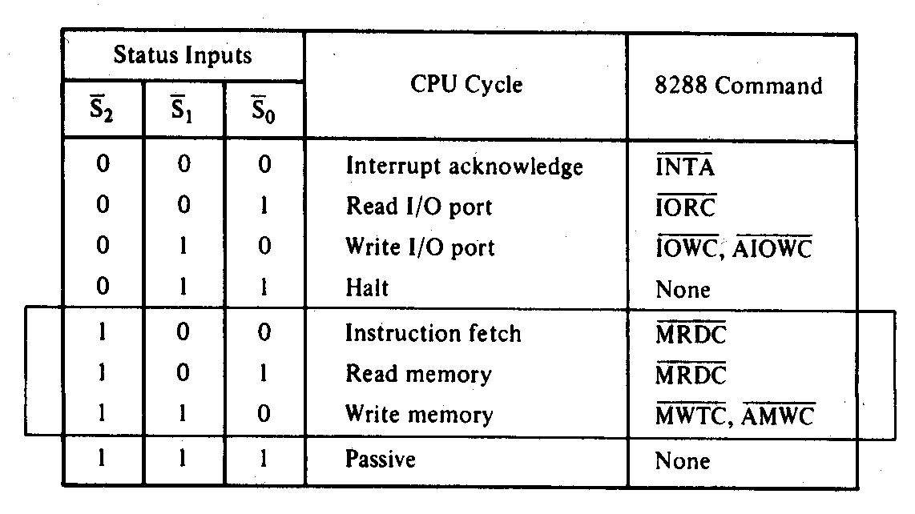
Memory Control Signals (cont.)
 Maximum-mode memory control signals
 MRDC – Memory Read Command
 MWTC – Memory Write Command
d
 AMWC – Advanced Memory Write Comman

Slide 14
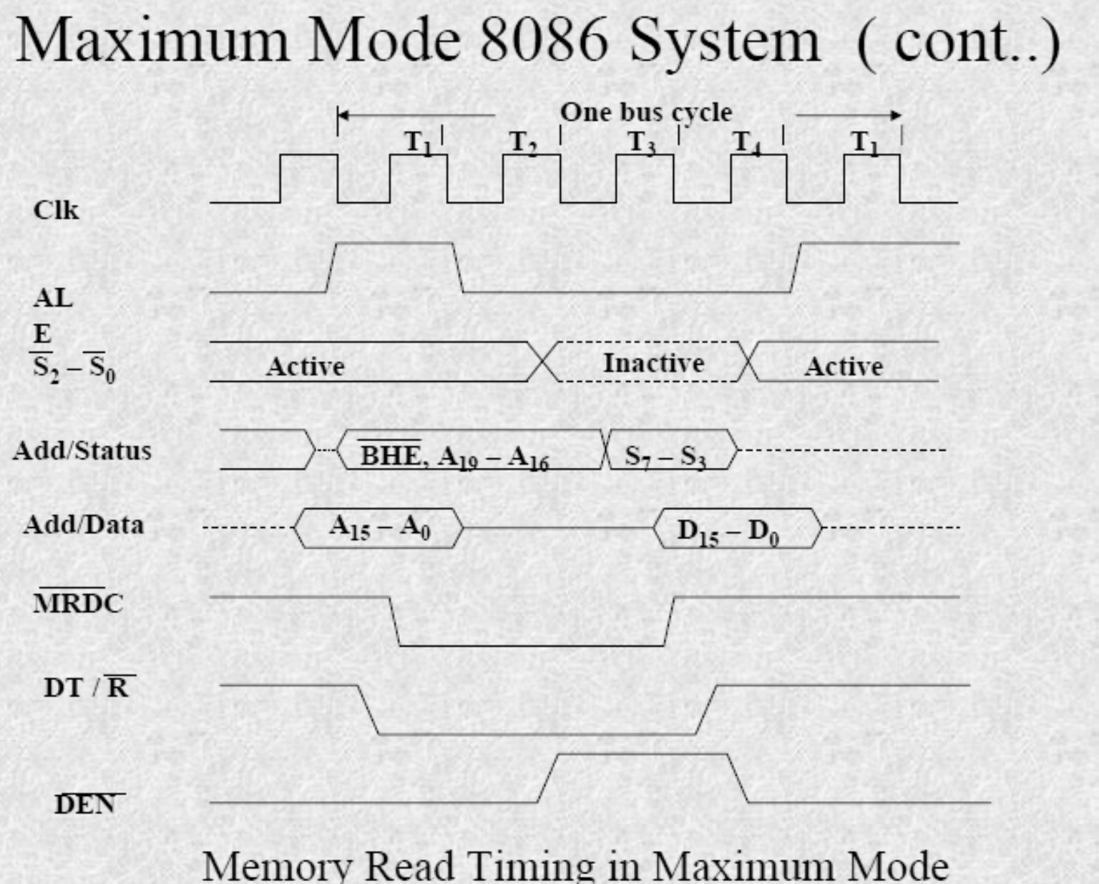
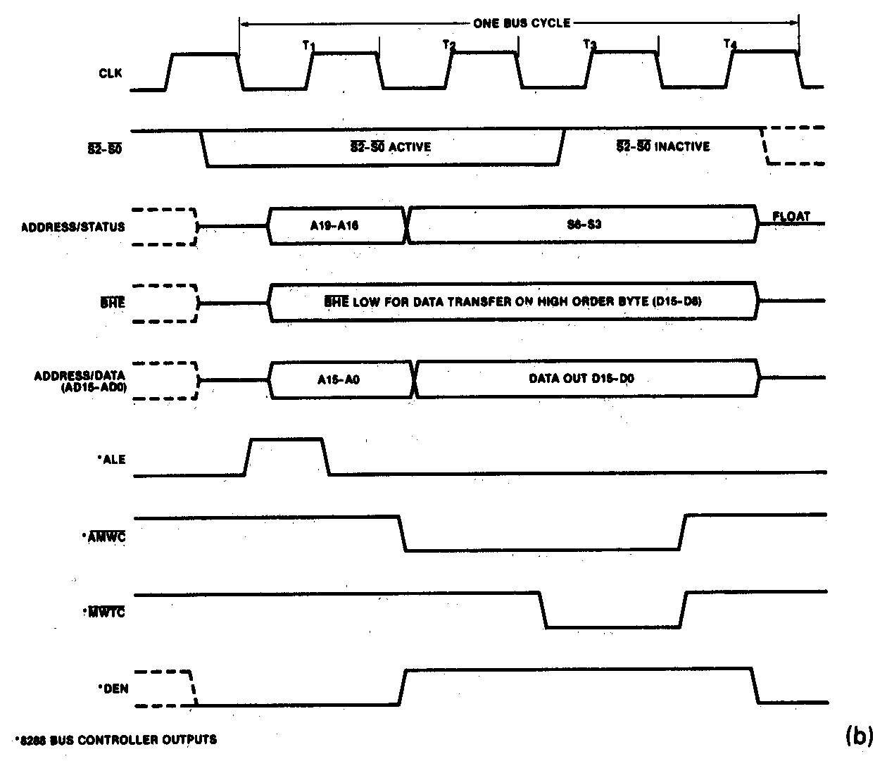
Read and Write Bus Cycle (cont.)
Maximum-mode memory write bus cycle of the 8086
 Write cycle

Slide 15
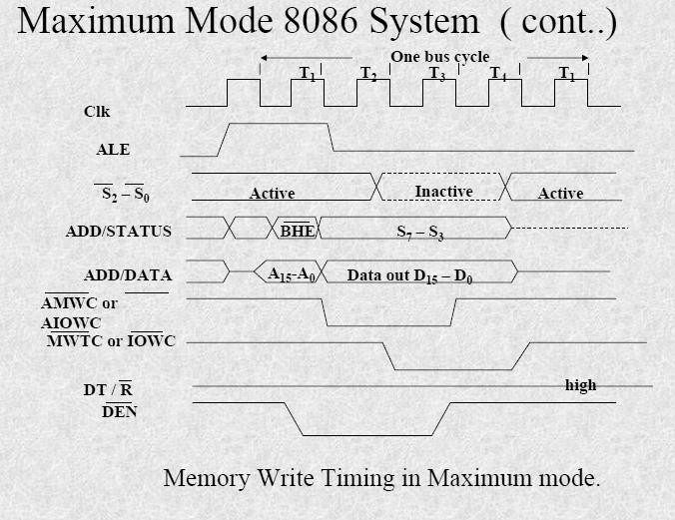
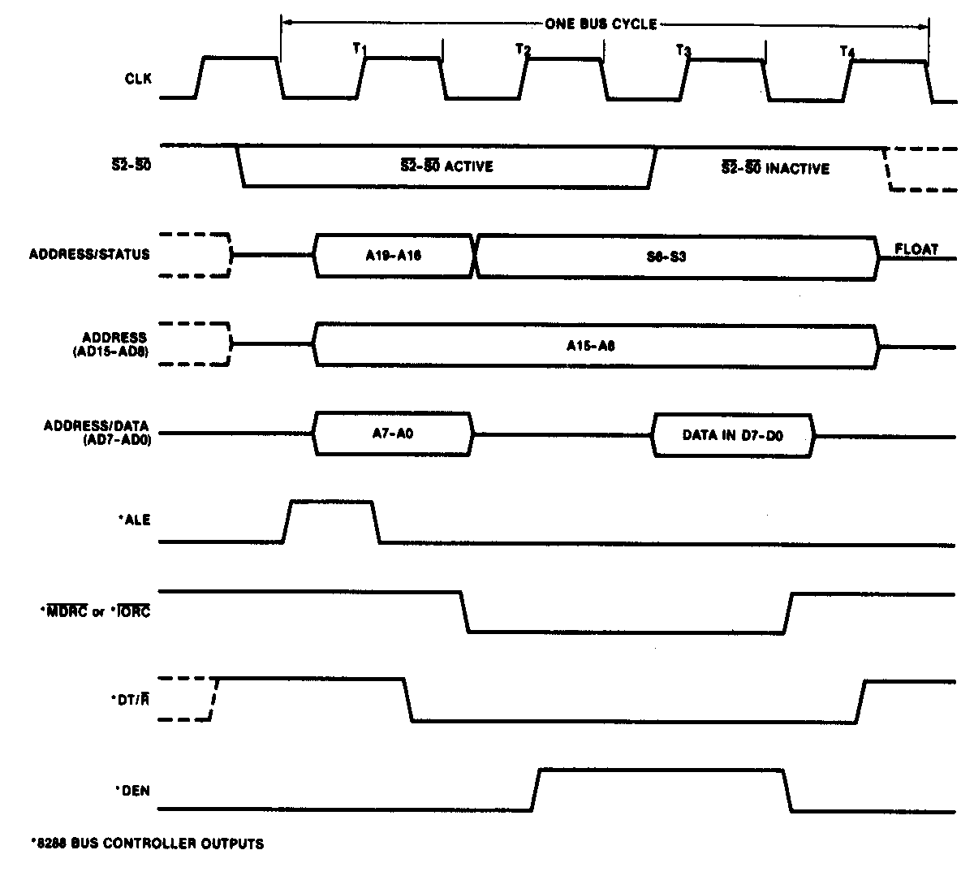
Read and Write Bus Cycle (cont.)
Maximum-mode memory read bus cycle of the 8086
Read cycle

Slide 16
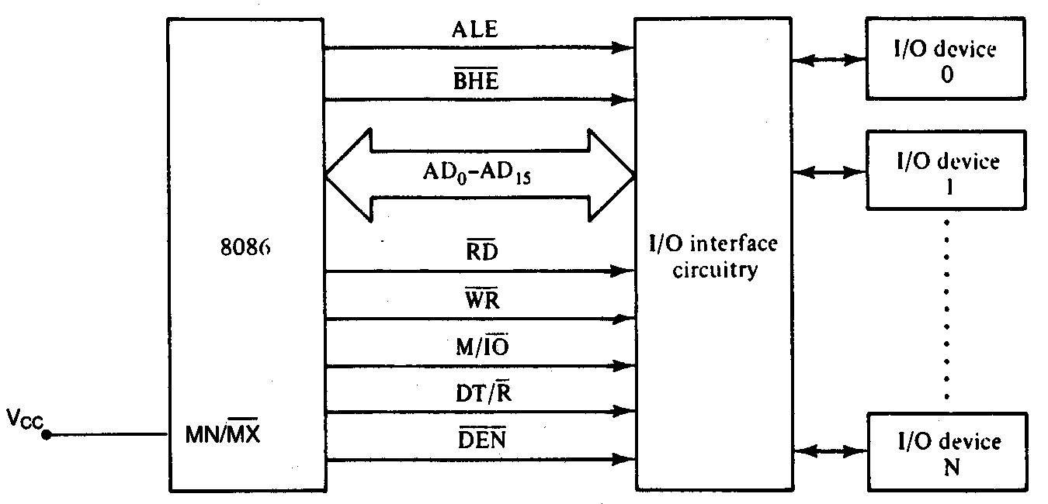
Isolated Input/Output Interface
 Minimum-mode interface
Minimum-mode 8086 system I/O interface

Slide 17
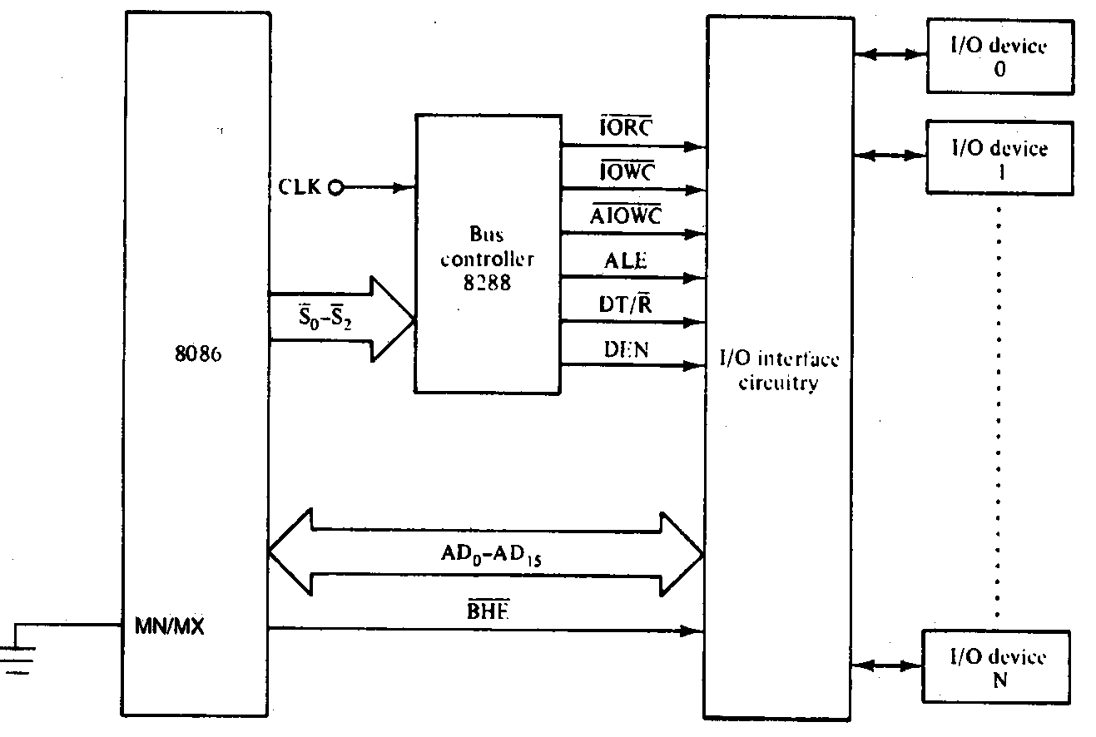
Isolated Input/Output Interface (cont.)

Maximum-mode interface
Maximum-mode 8086 system I/O interface

Slide 18
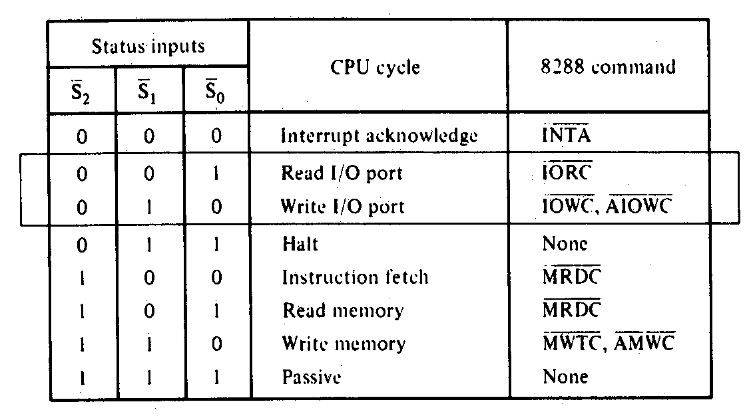
Isolated Input/Output Interface (cont.)
 Maximum-mode interface
I/O bus cycle status codes

Slide 19
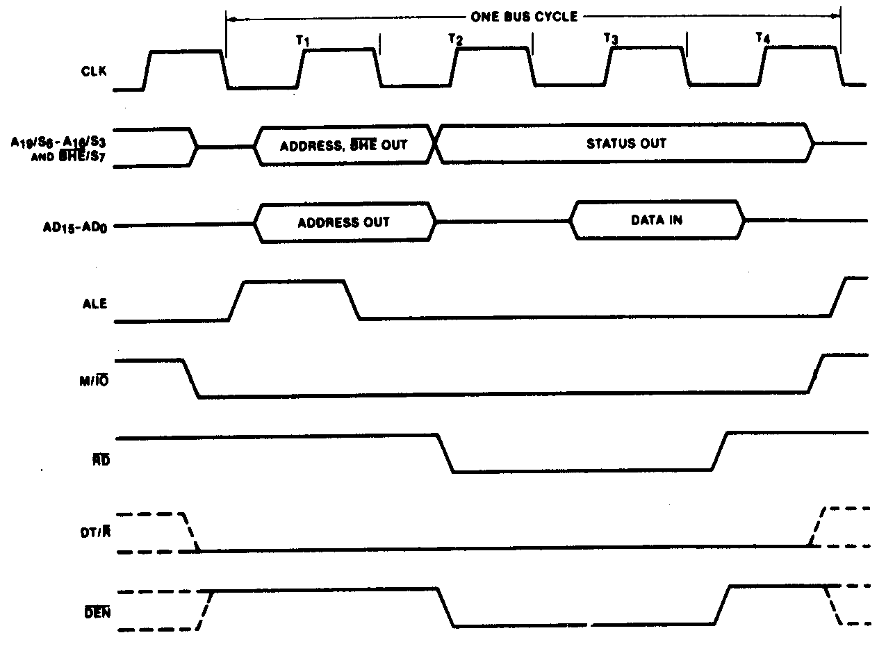
Input/Output Bus Cycles (cont.)
 Input bus cycle of the 8086

Slide 20
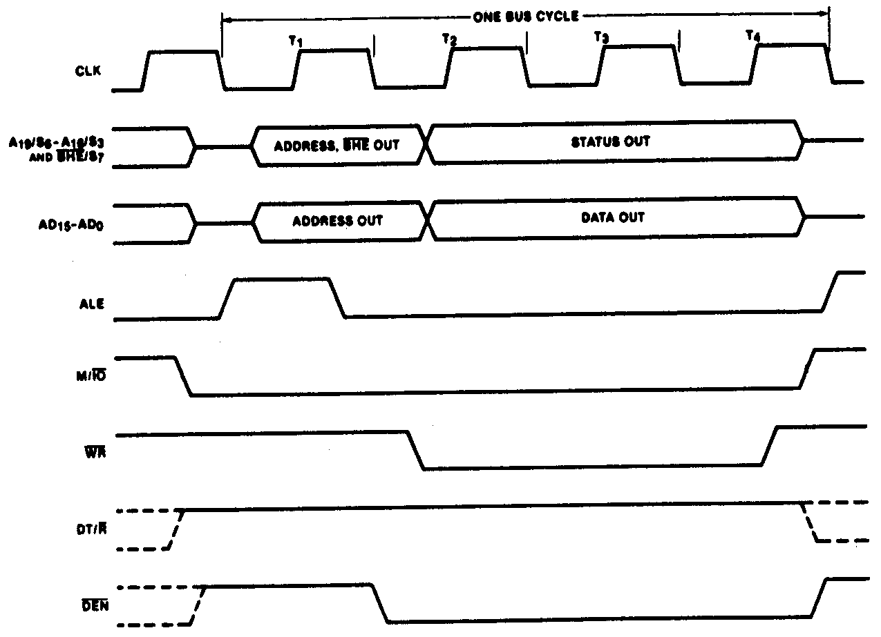
Input/Output Bus Cycles (cont.)
 Output bus cycle of the 8086

